Slide 1


Nintendo | Company profile
Headquarters | Kyoto, Japan
Founded | 1947
# Employees | 6,574
President | Shigeru Miyamoto
Overview
Revenue $ 2,96,97,844
EBITDA $ 64,02,921
Equity Value $98,802
What the company does:
Nintendo develops and publishes interactive entertainment, creating video game hardware, software, and iconic entertainment franchises worldwide.
Industry position:
Nintendo is a leading global video game company, competing with Sony and Microsoft while differentiating through exclusive intellectual property.
Products sold:
The company sells gaming consoles, video games, digital content, mobile games, and character-based merchandise and licensing.
Company history & reputation:
Founded in 1889, Nintendo has a long-standing reputation for innovation, family-friendly content, and globally trusted brands.
Please fill in key information from the 10-K
Historical Financials ($ in Billions)
Strategic Rationale
Create a chart showing Revenue and EBITDA from 2017-2021
Strengthen Gaming Capabilities – Webflix would be able to immediately accelerate its internal video game content capabilities, allowing it to create stronger, “stickier” relationships with its existing customer base while also serving to expand the size of its total addressable market
Deepen Penetration in APAC Region– By acquiring Nintendo, Webflix would be able to bolster its market penetration in the key Asia-Pacific region, for which it generated
Revenue by Geography
Representative Franchise Assets
Pie chart showing Revenue by Geography
Notes:
The strategic acquisition of Octane Fitness, which emphasizes core competencies in specialty retail and international distribution channels, is complementary to Nautilus’ strengths in the direct-to-consumer and mass merchant retail sales, however, an acquisition of Pivotal 5 would further enhance

Slide 2
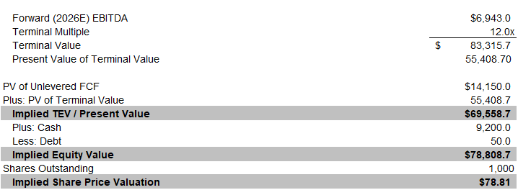
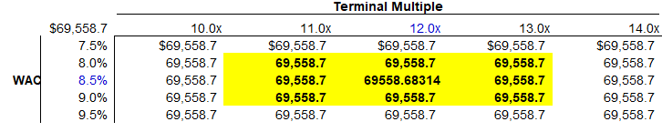
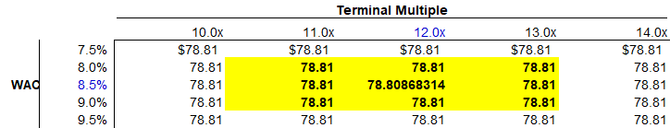
Nintendo | Discounted Cash Flow Analysis
Implied Enterprise Value & Equity Value from DCF
Enterprise Value
Implied Share Price
We believe Nintendo should be valued between $98B-120B, with a midpoint valuation of $110B

